Slide 2
PACARC’s Changing Mission
January 5, 2016
Michael Mart, KF5HWM

Slide 3
PACARC’s Mission Statement
The mission of the Palestine/Anderson County Amateur Radio Club is to provide emergency communications services to the community; to assist other civic organizations; to promote the technical craft of amateur radio through class training and testing; to mentor new members; and enhance fellowship among radio amateurs.

Slide 4
The Post 9/11 World
Continuity of Government is the focus
Plenty of money available for governments to become more resilient to disasters
  Redundant communications systems
  Backup generators
Less need for Ham Radio “when all else fails”
Less focus on civilians
You are on your own for the first 72 hours

Slide 5



Civilians use Cell Phones

Slide 6
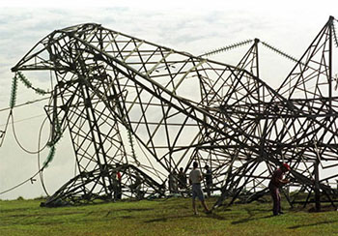
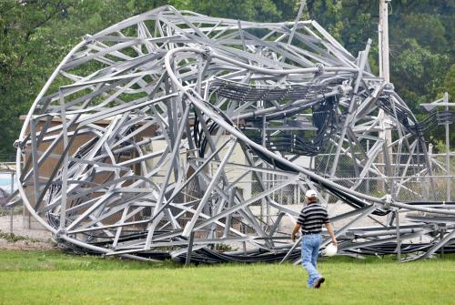
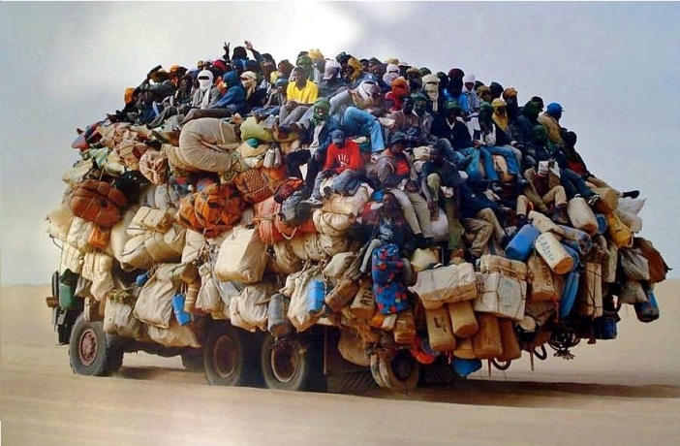
Threats to Civilian Communication
Loss of electrical power
Loss of cell towers
System overload

Slide 7
Disasters Cause All Three
Natural
  Tornadoes
  Hurricanes
  Wildfires
  Earthquakes
  Solar Storms
Man-made
  Terrorist attack

Slide 8
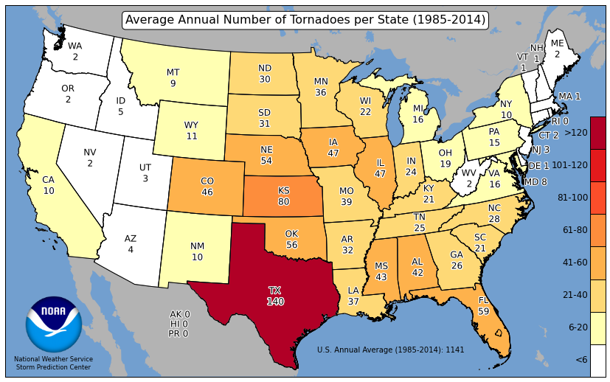
Average Annual Number of
Tornadoes per State

Slide 9
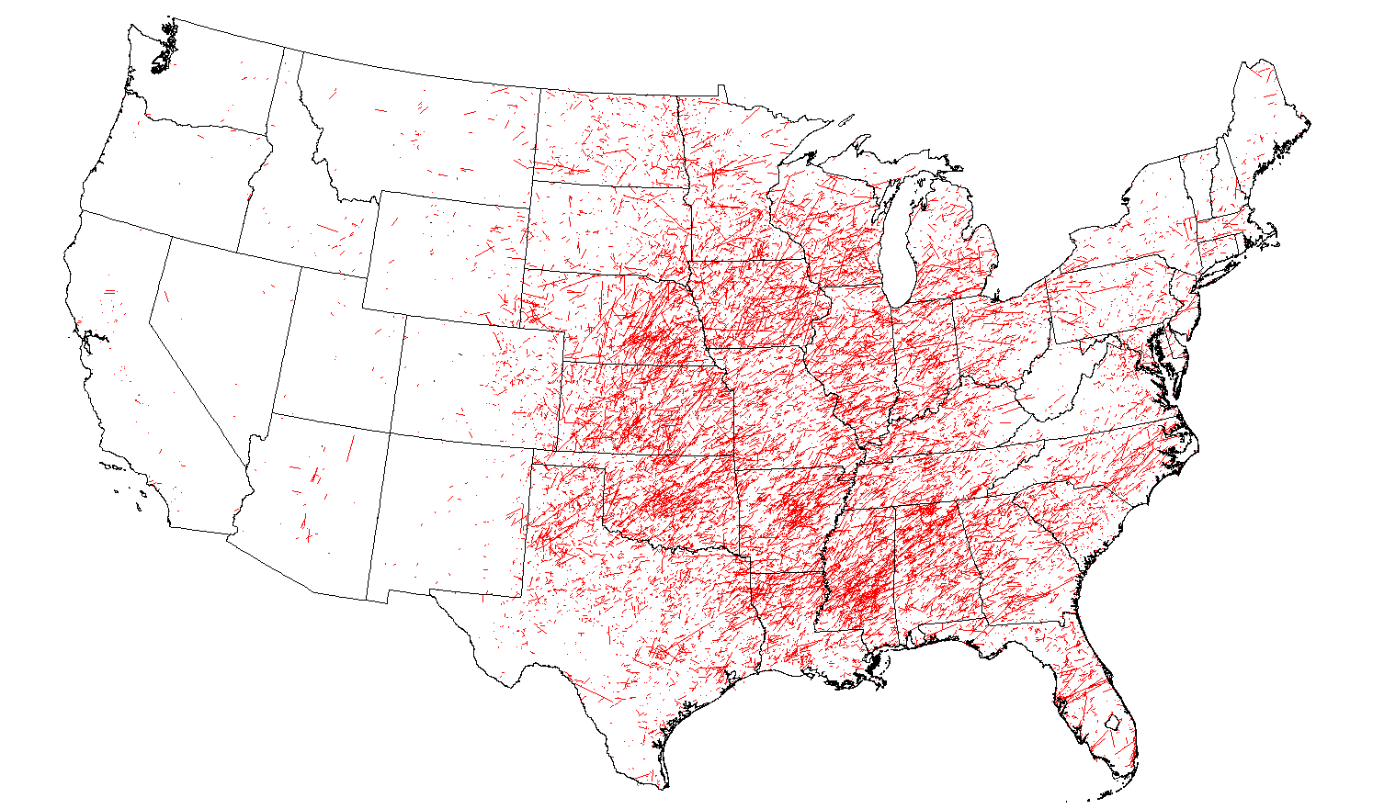
Tornado Tracks (1985 – 2014)

Slide 10
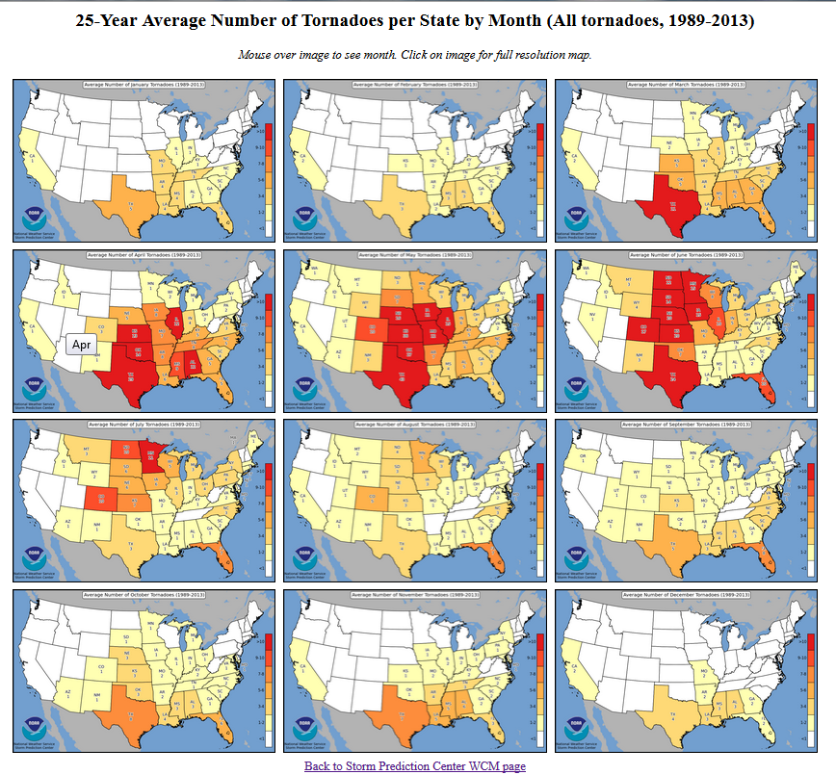
Tornado Threat by Month

Slide 11
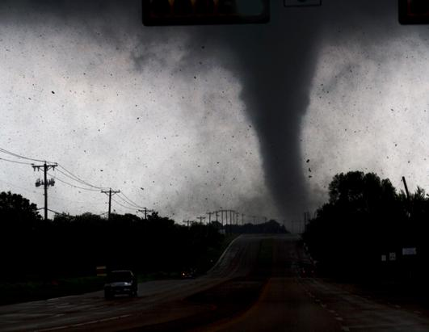
Texas Tornado Facts (1950 to 2014)
8,247 tornadoes
  Six F5 (<0.1%)
  47 F4 (0.6%)
  299 F3 (3.6%)
  1,157 F2 (14%)
  2,275 F1 (28%)
  4,252 F0 (52%)
  211 F? (2.6%)
562 people killed
8,487 people injured
F2 tornado in Lancaster, Texas on April 3, 2012

Slide 12
Deadliest East Texas Tornadoes
05/06/1930 - F4 - Hill/Navarro/Ellis - 41 killed
04/09/1919 - F4 - Henderson/Van Zandt - 17 killed
01/04/1946 - F4 - Anderson - 15 killed
03/30/1933 - F3 - Angelina/Nacogdoches - 13 killed
02/08/1935 - F2 - Leon/Houston - 12 killed
- - -
05/10/2015 - F3 - Van Zandt - 2 killed
11/15/1987 - F3 - Anderson - 1 killed

Slide 13
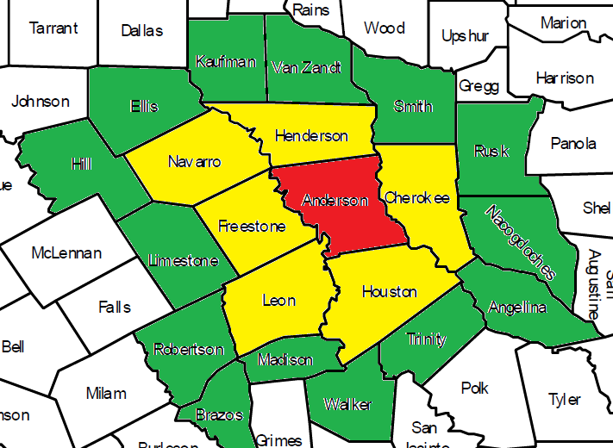
East Texas Counties

Slide 14
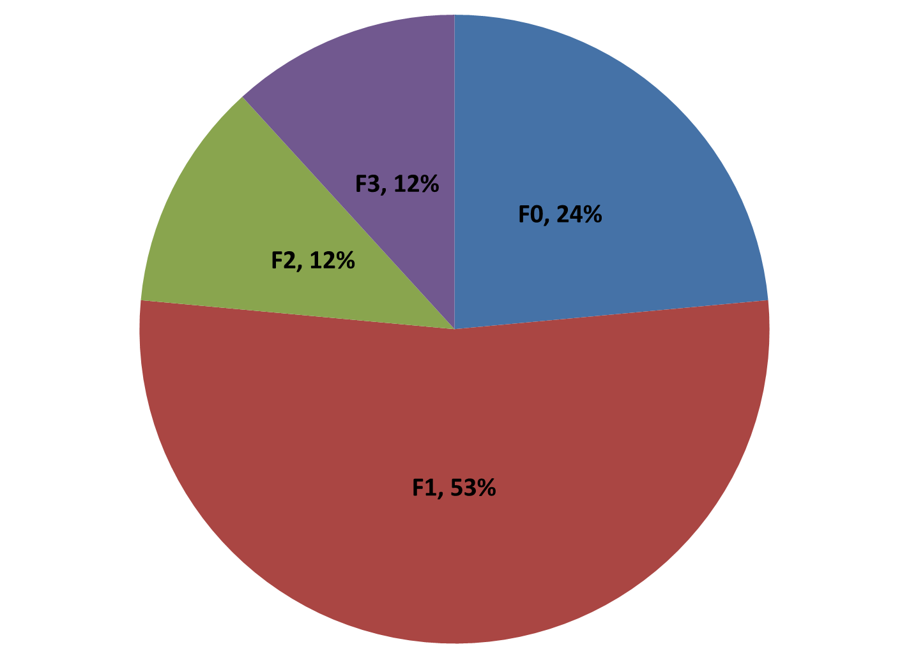
Anderson County
Averages one tornado every two years

Slide 15
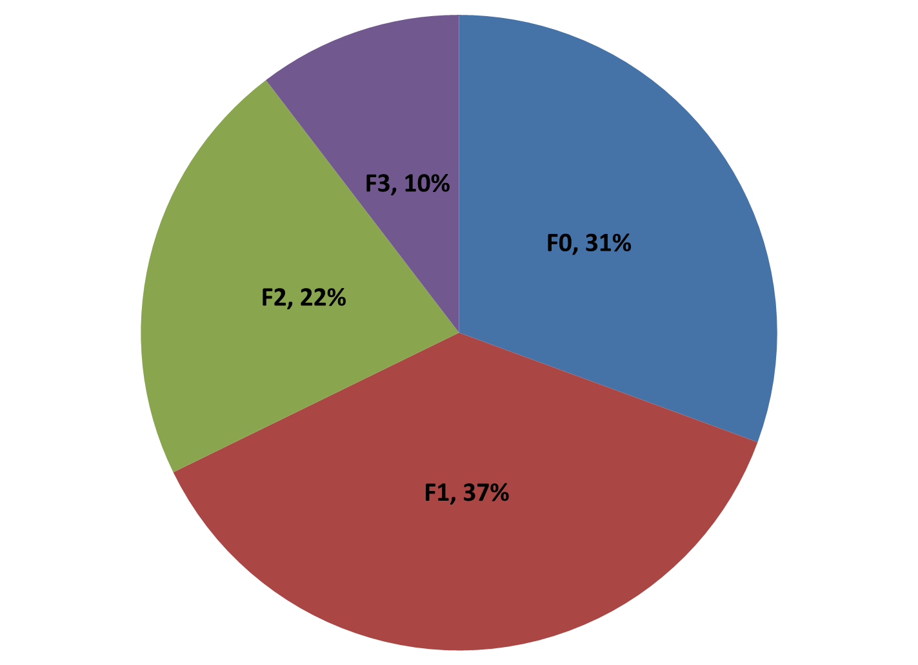
Anderson +1 neighboring county
Averages three tornadoes every year

Slide 16
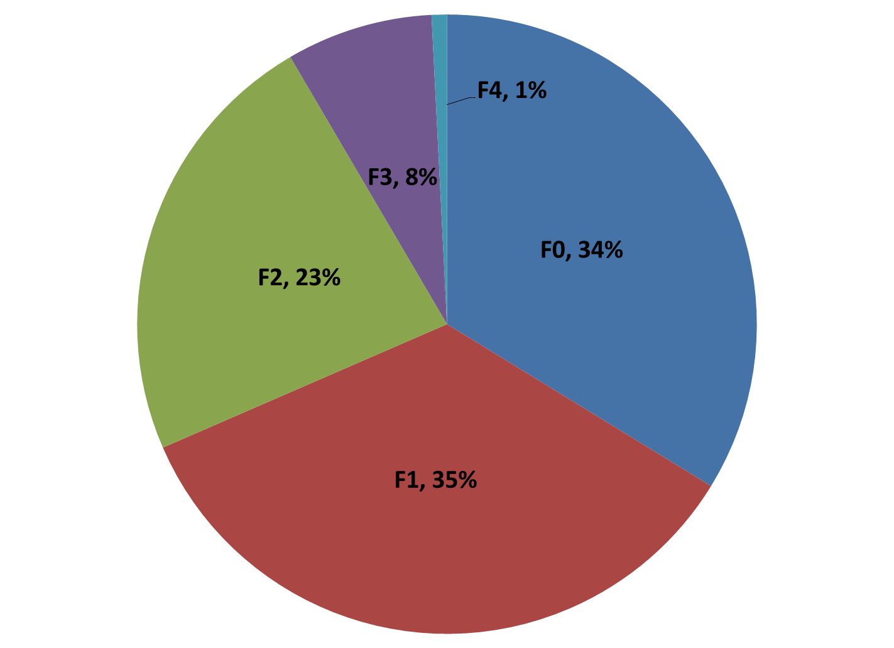
Anderson +2 neighboring counties
Averages ten tornadoes every year

Slide 17
Spring/2015 East Texas Tornadoes
Apr 9 – F2 – Cherokee
Apr 24 – F0 – Ellis
Apr 26 – F0 - Hill
May 10 – F? – Hill
May 10 – F1 – Smith
May 10 – F1 – Smith
May 10 – F3 – Van Zandt (2 killed, 47 injured, $40 M)
May 11 – F1 – Cherokee
May 19 – F0 – Ellis
May 25 – F2 – Rusk (15 homes destroyed, 250 damaged)

Slide 18
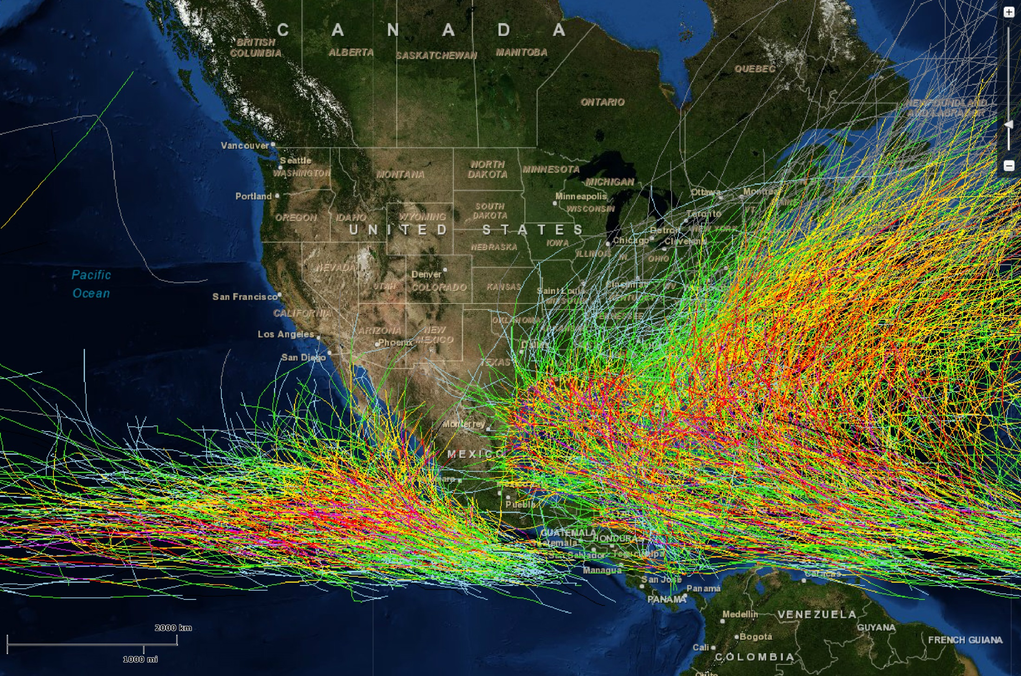
Hurricane Tracks 1958 - 2011

Slide 19
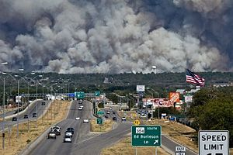
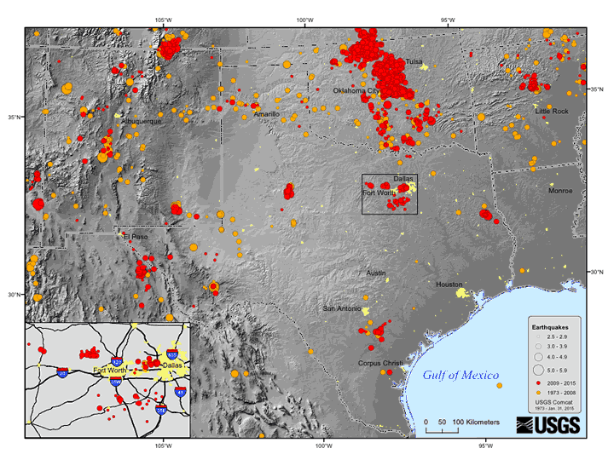
Other Disasters
Wildfires
  09/04/2011 Bastrop County
    1,673 homes destroyed
    2 people killed
    $325 million damage
Earthquakes
  Nacogdoches:
    9 quakes in last 3 years
    Largest 4.8 on 05/17/2012

Slide 20
“Provide emergency communications services to the community”
Instead of focusing on providing emergency communications to local government organizations, let’s change our focus to providing emergency communications to civilians in our community

Slide 21
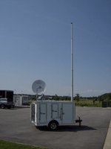
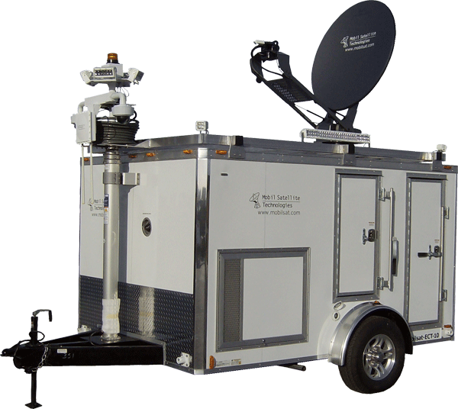
Emergency Communications Trailer

Slide 22
Civilian Communication Functions
Satellite/Local TV reception (e.g. DISH/Direct TV)
  Outdoor television display with speakers
Satellite Internet (e.g. Exede/Hughes)
  Voice Over Internet Protocol (e.g. Vonage/Ooma)
  WiFi hot spot
    Video conferencing (e.g. Skype/Facetime)
    Send/receive e-mails (e.g. Outlook/Gmail)
    Web browsing (e.g. Firefox/Internet Explorer)
    Smart phone apps (e.g. iOS//Android/Windows)
Low power FM broadcasting
Electrical recharging station

Slide 23
Operator Communication Functions
Amateur Radio
  HF: 80m/40m NVIS regional
  VHF/UHF: 2m/70cm local
Scanner
  Police
  Fire
  Local disaster response
Weather Alert
Public address system
Low power FM broadcasting
Laser printer (Flyers, bulletins, etc.)

Slide 24
Emergency Response Timeline
00:00 – Disaster event occurs
03:00 – Local emergency officials determine need for emergency communications trailer
04:00 – Emergency communications operators gather for travel to disaster site
06:00 – Emergency communications operators arrive at disaster site
Plan for a maximum of one week deployment

Slide 25
Emergency Communications Team
In Transit:
  Driver
  Navigator
  Communicator
On Scene:
  Three offset shifts, providing for:
    One 8-hour block of sleep
    Five 2-hour work blocks
    Six 1-hour meals/breaks
    Always 1 or 2 operators on duty

Slide 26
Disaster Site Set Up Tasks
Tent
Porta Potty
Emergency Power (Generator/Solar Panels?)
Antenna
Television
Tables
Awning

Slide 27
Funding Sources
Civic organizations (K of C, Rotarians, etc.)
Private businesses (Walmart, etc.)
Other amateur radio clubs
Government grants?
Others?

Slide 28
The Next Steps
Establish a committee to:
  Specify equipment
  Estimate costs
  Determine deployment protocol
  Establish project timeline
Committee reports to PACARC for approval

Slide 29
Questions?

